Slide 1

Bulk Material Transport and Handling Systems
Off-Highway Trucks and Haul Roads (2)
Prof. Khanindra PathakDepartment of Mining EngineeringIndian Institute of Technology, KharagpurLecture - 40
Welcome back to our discussions on this transportation machinery for surface mines and though there are number of different machines will be introduced to you. But in the last class I introduced what are these off highway trucks that is the large capacity mining trucks or we say it says sometimes the other words used for this hauler you use as a dumper, dump truck. But basically, these are automobiles that are which has got its own power for its propelling and then it has got carrying.

Slide 2
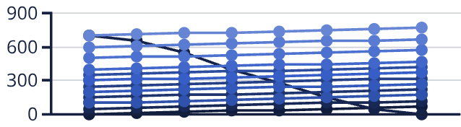
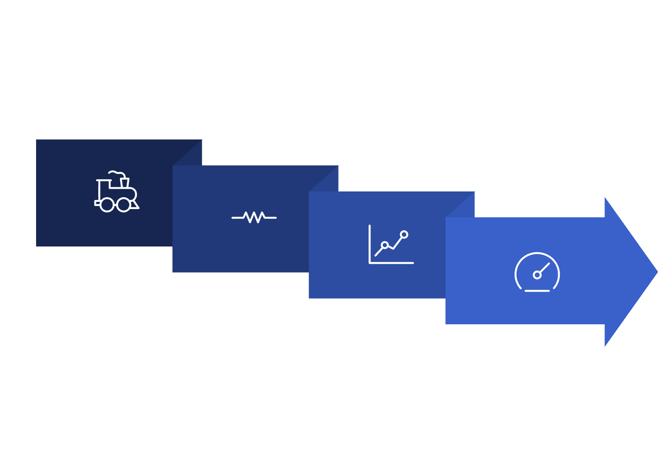

Power Requirements and Engine Performance
Understanding power requirements is crucial for selecting appropriate off-highway trucks. This involves analyzing the resistances the truck must overcome. Our focus today is on practical aspects: interpreting Rimpull and Retarder curves provided by manufacturers to determine vehicle speed and performance for specific applications.
Speed (km/h)
Available Rimpull (kN)
Required Rimpull (0% Grade,...
Required Rimpull (5% Grade,...
Required Rimpull (10% Grade...
Required Rimpull (15% Grade...
Required Rimpull (20% Grade...
Required Rimpull (25% Grade...
Required Rimpull (30% Grade...
Resistance
Required Rimpull (0% Grade,...
Required Rimpull (5% Grade,...
Required Rimpull (10% Grade...
Speed Select
Required Rimpull (15% Grade...
Required Rimpull (20% Grade...
Required Rimpull (25% Grade...
Required Rimpull (30% Grade...
Power Req
Rimpull Curves
Mining Truck Rimpull Performance
This graph illustrates the available rimpull from the truck's engine and the required rimpull to overcome various grade resistances, for both loaded and empty conditions. The intersection of the available rimpull curve and a required rimpull curve indicates the maximum sustainable speed for that specific grade and load.

Slide 3
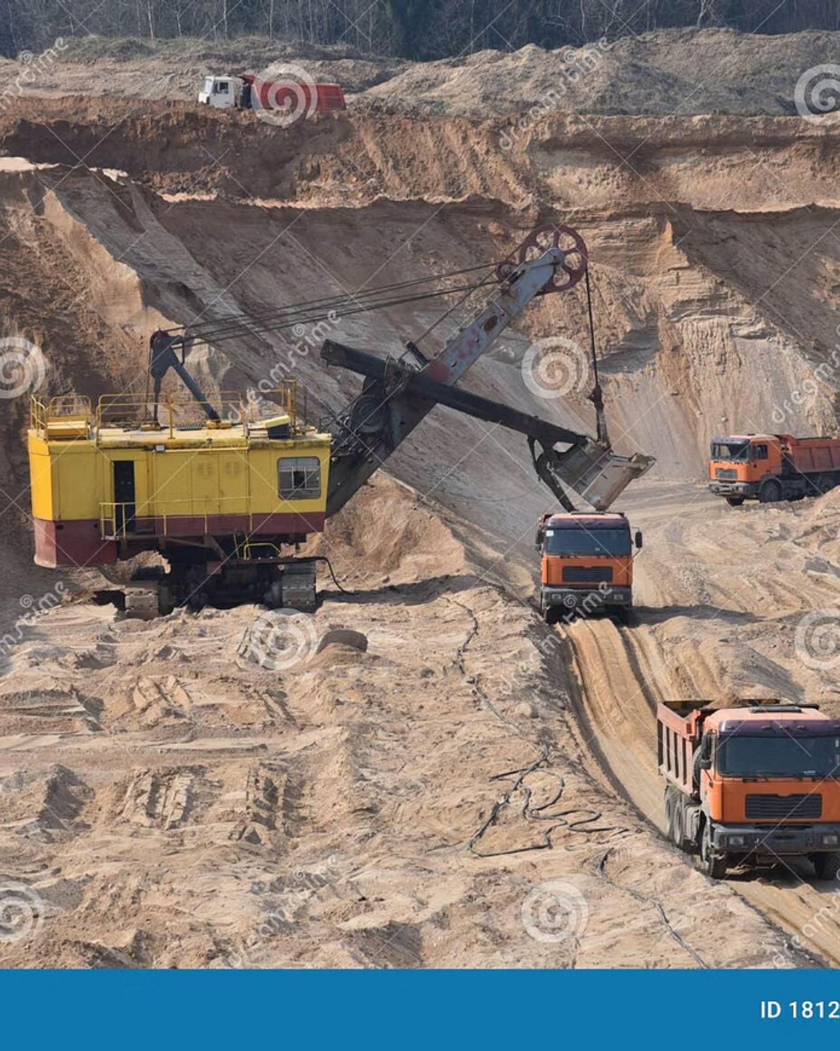
Working Conditions in Mines
You see that such truck when it is working in a mines. This figure is showing that your mining haul road it is not a very uneven road and then when they are working in conjunctions with your shovel that will be loading on to this truck you can see the working condition is very rough and tough. So, in that when such machines will have to work that is the dumper it is taking this load when that when the shovel is loading to the dumper it is getting a shock load on it.
At the same time that when this haul mass the total mass it will be accelerated. So, during the time that engine will be having a different type of load that is the characteristics of the engine will have to be determined so that it can provide that power. So, this is one of the very important things about knowing about this truck.

Slide 4
Truck Dimensions and Specifications
Now, that as a dimensionally this truck you can see here it is only about on 122 tonne dump truck. It is having 6.38 meter there are even bigger and larger truck like that is height, the width you can see from the front it is ever 6.6 and in the back side when you see that there are suspensions and the truck. So, you need to how this mining truck of large dimensions will have to be there.
So, when we talk about this machine, that our basic thing is that what are the resistances it will have to overcome and then what is attractive effort how this vehicle will get accelerated, how that exactly the braking will be done how this machine will be controlled. So, maybe that regarding the accelerating breaking or stopping distances calculations and all maybe we will be covering in our another class. Today let us see first what are these resistances.

Slide 5
Types of Resistances
Aerodynamic Resistance
Now, you know that three types of resistances are very common when a that is it will have to be overcome and to overcome this resistances power will have to come from the engine. Now, these aerodynamic resistances it is the air resistance. Say for example you can see in that figure that when the truck is moving the air will be giving a resistance to it that is why whether the tire has got a, mirrors it has got a front size.
That how the front portions what is the area of it which will be taking up these haul resistances. So, it depend exactly the turbulent air flow around the vehicle body this gives about more than 85% about the resistances. Then friction of the air over the haul vehicle body that comes about 12% and the vehicle component resistance from the radiators and the air vents.
And these other things there also this there about 3% like that this haul air resistance is contributing and that total air resistance are calculated there are this the mainly on these coefficients. And then your the velocity and the area and the density of that air which is going over there that affect this resistances.

Slide 6
Rolling Resistance
Understanding Rolling Resistance
Contributing Factors
Rolling resistance is the resistance which is coming from the tire and road interactions. There are different ways of calculating determining that in the field but we have not done much of these experimental determinations many a times we take the rolling that frictional the resistance that rolling friction.
That rolling resistance it is also contributed from the tire deformation. Because as the tire the new tire and that old tire when their tire is having even a cart and all at that time this tire is a main component from where the tire trade how it is designed. Those things also a lot of this mechanical engineers do study that by how the trades of the tire will be there.
Rolling friction is taken that f rl from other data or some secondary data. But there is a need for our different types of haul roads we need to develop that resistance because, they if we know the rolling resistance and the W the vehicle weight then you can find out that what will be these rolling resistances can be calculated very easily.
You might have seen that in the trades there are lot of gap. Now in that gap when the tire will be moving over there that the gap will be exactly working as a pump.
And then the whatever the fluid or dust which will be coming over there that will be thrown out away this sides. So, that is why how the tire trade will be interacting with the road is another issue. But the resistance comes to that is a haul rolling resistance 90% contributions from there. Then, also when the tire will be penetrating that means if the ground is of your softer nature that ground bearing pressure is less.
It will be giving a penetration that will contribute to rolling resistance. Then also when the tire is that it will be moving if the rule the resistance is less on the road, then it will be started this air slipping that try and then. And there will be air circulation around the wheel when it slips, means around the wheel there will be air coming over there. Then wide range of factors that may affect the total rolling resistance.
Because, that what is the rain conditions what are the grain size of the what are the type of potholes on the road that there are many things over there. That frictional resistance how it will be determined that is exactly experimentally done some of this relationship is given in that f ps system. But we will be looking into things of this rolling resistance from the standard values which are exactly adopted as a standard practice from there you need to calculate.

Slide 7
Grade Resistance and Tractive Effort
Grade Resistance
Then the third component is the grade resistance, you know when the vehicle is moving on a grade whether it is going up or going down that angle theta z here which is the angle of inclination depending on that this your W sin theta component will be coming. And as it is becoming a horizontal that component is going missing. And this is the way how exactly the grade resistance will activated.
The total resistance will be sum of all these resistances. Then the other concept which is necessary is a tractive effort.
Tractive Effort
This is another very important thing that what is attractive effort for a truck or the attractive force is the total traction a vehicle exerts on a surface. That means when that engine is running at that time that your will which will rotate at that time how much exactly the vehicle can be propelled, how much it can be tracked that is the amount of the total traction in is in the parallel to the direction of motion.
If it is going in addition along with that will be coming your different surface whatever the surface on which there the traction force is parallel to that. Now, the force available at the contact between the drive wheel and tires on road is known as the attractive effort. Basically, when you see here, that is your if you take this when any wheel will be here say for example when a wheel will be rotating over a surface over any surface that time exactly you are will rotating in this direction.
Now, if you are travelling in here there will be in these directions then there will be resistances coming over here. And then how much exactly the traction force you will be getting over here. Now, this is one of the very important things on any transportation equipment that how you are the attractive effort or the attractive force will be coming over here. The force available at the; contact between the wheel and the tire road.
That is the attractive effort how much exactly you will be able to pull in this at the point of contact of the point of contact here how much exactly you are going to get to overcome the resistances which is coming as a resistance that resistance will be overcome and then you will be getting an effort. The ability to drive a will to transmit this effort without slipping is the traction.
Now, the usable tractive effort it will never exceed the traction. This terminology should be clear in your mind. Now, that another thing is proceed to the next discussion is how will, you calculate the attractive effort.

Slide 8

Calculating Tractive Effort
Because this is related to your engine power. That is how that engine will be used using that how the engine will be delivering the power to get the traction. So, you know that engine torque it is exactly what is the engine brake power given in kilowatt if it is P e and then your this the crankshaft of that engine crankshaft is giving a rotation of N rpm. Then this tractive engine torque you are finding it in newton meter as given in this equation.
01
02
03
Engine Torque Calculation
Torque at Drive Wheel
Tractive Effort
Calculate the tractive engine torque using engine brake power (Pe) in kilowatt and crankshaft rotation (N) in rpm to get torque in newton meter.
Determine torque at the drive wheel depending on gear ratio, axial ratio (overall gear ratio), efficiency of transmission, and engine torque.
Calculate tractive effort based on the radius of the tire. Since torque equals force times distance, divide torque by tire radius to get tractive effort.
Similarly, when you find that say you are having this equation for getting the track engine torque. Now, that torque at the drive wheel that is more important and this will depend on the your gear ratio and axial ratio. The product of these two it is called your overall gear ratio and then efficiency of the transmission and that engine torque. So, this will give you what will be the torque at your wheel.
Now, then the tractive effort is depending on what is the radius of the tire that is that your you are having this torque. Torque is nothing but that force into the resistance so from there you can find out. So, if you break it up so this equation will give you attractive effort. So, sometimes when you do that whether distractive if your required tractive effort from the road conditions and all you calculate the resistances.
And if this is not coming and then your that engine power will be insufficient to draw that truck. So, this is a basic concept you should have when the attractive effort if it is greater than the total resistance on the level road the surplus tractive effort is utilized for acceleration. That is on a hill climbing and draw bar pull all that draw bar pull means if you are something with your driving you are at giving an articulated drum truck.
That is your when you are connecting the dumb body to the your the tractor part there whether how much pull how much exactly load it can pull that is the draw bar pull can be calculated.

Slide 9
Available Tractive Effort
Key Concept
Now that if your force generated by the engine is known and the maximum value of is the function of the vehicle's weight distribution and the road tire interactions. These two that means your whatever the available minimum effort will be that minimum of these two whether the force generated by the engine is how much and then what is the maximum value of that function of the vehicle.
Available tractive effort is how much force the vehicle can actually use to move.
So, weight distribution on the road tire interactions, these two whatever is the minimum that will be your available attractive effort.

Slide 10
Drawbar Pull
Now, this concept, as I said that drawbar pull whenever you talk of a dozer whenever you talk of a this scraper whenever you are talking of a tractor whenever you are talking of any this your towed vehicle the drawbar pull is the amount of horizontal force available to a vehicle at the drawbar that where it is getting connected for accelerating or pulling the load. So, all your side discharge dump trucks your the that your rear your bottom distance dump truck.
If it is an articulated drum truck you are adding that thing that that drawbar pull will be very, very important which is a function of the velocity. And generally, this drawbar pull it will decrease as the speed of the vehicle increases because when you are getting more energy for accelerating it or increasing this one then the other side your that available for pulling it will be less.
So, that means when you are having a very heavy load at that time you will not be able to give a very high acceleration to get to a higher speed. That is a general basic concept. So, drawbar pull is the difference between the attractive effort available and tractive effort required to overcome the resistance at a specified speed. So, once you have got these concepts clear then you can do some numericals over here.

Slide 11





Numerical Example: Drawbar Power Calculation
Problem Statement
Let us consider one truck with a rear wheel drive which the following specifications. A rear wheel rolling resist radius it is say 800 millimetre, that is your the radiate rolling resistant from here this radius is 800 millimetre and the tractive force is 22 or we say I thought that this is 22 kilo newton it is your because this direction it is moving in this direction. So, that is your tractive force is giving 22 kilo newton.
And a will slip this wheel is slipping here at a 12% slip. Now, the engine is capable of rotating at a 2400 rpm and the transmission ratio that is your total gear ratio is say 120 is to 1. Now the truck experiences a motion a resistance of 2 kilo newton, that is a motion resistance in rolling resistance road resistance all this thing is 20 kilo newton. Now, what will be the drawbar power that how much power will have to be given by the engine here.
Solution Steps
Calculate Drawbar Pull
Drawbar pull is the difference of tractive force (22 kN) and motion resistance (20 kN). Both forces are horizontal and parallel to the road.
Find Rear Wheel Speed
Engine speed is 2400 rpm, transmission ratio is 120:1. Rear wheel speed = 2400/120 = 20 rpm.
Calculate Theoretical Speed
With rolling radius 800mm, theoretical speed = 2πrN/60 = 1.7 m/s.
Account for Slip
With 12% slip, actual velocity = 1.7 - (0.12 × 1.7) = 1.47 m/s.
Find Drawbar Power
Drawbar power = drawbar pull × velocity = 29.5 kW.
Now, one thing is very simple drawbar pull which will be the difference of these forces. It is a vector force by the same they did they are both in the horizontal parallel to the road. So, their differences will give you the drawbar pull. Now, from this drawbar pull how will you get the drawbar power? As you know that engine speed is given your 2400 rpm and the transmission ratio is given.
So, what will be the rear wheel speed? That if you divide by the that ratio that means it will be rotating that is if the engine is rotating at 2400 rpm, at least rear wheel will start rotating at 20 rpm. When this rolling resistance is radius is your 800 millimetres. So, therefore you can find out that what will be the theoretical speed? Theoretical speed will be coming as your 2 pi r N by 60 that formula you apply 2 pi r N by 60 is your 1.7 meter per second here for this given data.
So, then what will be the actual velocity? Actual velocity will not be this much because we have said that here is a 12% slip. So, because of the slip certain rpm will get lost over here. So, you subtract that so you are getting the speed that whatever that at with that load and with that pull it can run at a velocity of 1.47 meter per second. So, that means the drawbar pull is nothing but that with that newton force it is moving at this much speed.
So, we are getting the drawbar power is 29.5 kilowatt. Now, whatever your this engine rating was there if it is less than that then the engine will not be able to give you this. So, that is how we just check whether a specifications given by a manufacturer whether it will be able to take our that will be suitable or not. So, such type of calculations you may have to do when you are working in field.

Slide 12
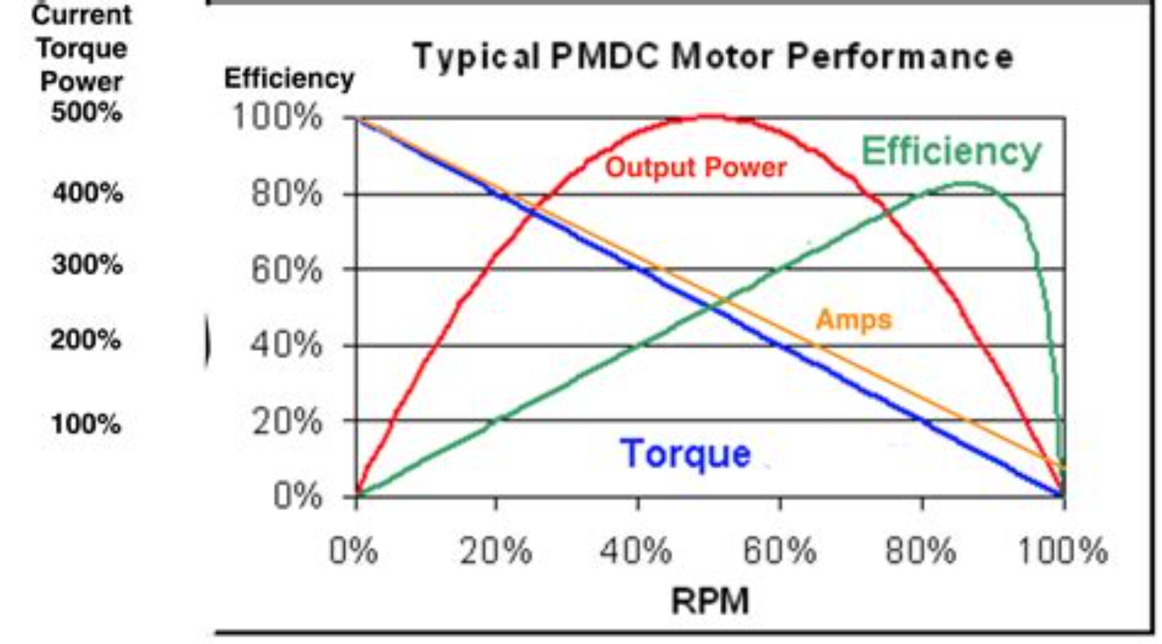
Torque and Power Curves
Now, then typically the torque power curve is given. Say if you are putting the engine power horsepower in this and then engine speed you will find that power curve is given like that and the available torque curve is given like that. So, this is your one of the optimal point so that means you can operate in the zone very easily.

Slide 13
Understanding the Rimpull Curve
So, then the other things which you need to know. Suppose here I am showing you one curve it is called your Rimpull curve. All the manufacturer they give that is for their machines they do experimentally determine and they provide this their Rimpull curves. That means how much exactly that pull or the force will be available when the car will be moving at different speeds. So, in this one you can see the speed is given and in this here the your pull is given.
Now, one thing is there in that curve in a your Rimpull curve, you will be given that that different unit normally nowadays they will get both the units you may have in fps and also in SI unit. And there this given at the different resistances that is your road resistances at different percent what will be there. And our say for this graph we will be using that to answer a question like how fast can a Volvo this truck Volvo truck go up a 12.5% grade.
You are having a haul road with 12.5% grade resistance with a 2.5% rolling resistance and a full load of 40.7-ton load when the vehicle weight is given over there that they have got its own weight then there is the your net weight this is your tarot weight. So, and under these conditions how will you determine the speed.

Slide 14
Using Rimpull Curves: Step-by-Step Example
Step 1: Determine Vehicle Weight
So, first what will have to do, what is your vehicle weight you need to find out. Now and then what exactly the for a particular vehicle when you get a Rimpull diagram, there will be one green line and one red line. This green line it will show that your Rimpull shows the weight of an empty truck this is this will give the weight of an empty truck that is here at 30 ton. And then when it is a full loaded because it is a 40-ton truck that means this is a 70 ton is the full load.
So, in that graph Rimpull diagram you will find out that exactly if you give more weight over here this will be going beyond. So, first you find out that and if you want to find out if you are going to have only 60 ton.
Step 2: Calculate Total Resistance
Now, how you determine the total resistance? Now for this 12.5% positive grade resistance working against a truck and this your rolling resistance is given the total resistance you can sum it up that will be your 15. So, you now go over here in this you find out that which curve which distance so here it is your 15% resistance. So, that means this is the your total grade resistance you will be taking up.
Step 3: Find Speed from Curve
And once you take that then from here you will be going towards this to find out. From here you will go and find here what is exactly your will be the speed. From here you can find out that the speed it is running at a say 7.5 kilometre per hour or that we can say this is giving a 5 mile per hour. So, that means if your this road is giving 15% resistance you are going over here.
Now, same thing that is your you can find out that is a if your resistance is suppose you are having a very tough road going as a 30% resistance in that case this will be here you will find it will go like that. And then your speed will be much less here over there. So, like this in this way you use your Rimpull diagram of the vehicle to find out in a particular route condition. So, these three factors are very important that your what is your total grade resistance and the total load which is coming and then what speed you will be moving.

Slide 15
Retarder Curves for Downgrade Operation
Once this is done the other thing is the retarder graph. So, here in a that exactly the retarder crops it is for a your favourable grade when you are working that is exactly your the vehicle is having different gears. So, under different gear they have got different speed. So, if your at the time of returning when you are going in a favourable gate in a downgrade at that time you will have to apply this resistances.
And under that condition at what speed you will be moving that is also determined from these curves. So, to do that you exactly you need to know that if you are going down the grade. In such type of things you will be finding out and from here.
Again, you just remove it with that your 10% gradient now your rolling resistance will be in a favourable. So, from the 15% you have come down over here and you can see in this case your speed gets down over here. So, this is the way how you determine that when you are retarding at that time the speed is increased but you will have to apply the brakes. So, that you do not over run.

Slide 16
Travel Time and Haul Road Segmentation
So, then once you know these things that from the speed you can find out what will be the travel time. The Rimpull and retarder curves they will represent the maximum speed the vehicle mechanically can achieve. So, you may the that have the congested areas or sharp turns where the travel speed must be lower or under that conditions if some when in a mines you will be going from one directions.
If another ramp is coming up over there at that time you will have to control the speech those other operational point will have to be taken. So, that we normally break the haul roads into segments. So, what is done in a mine that is your mine haul road will be showing sometimes that is exactly how the haul roads in a mines are designed. So, they will be having some horizontal parts there may be some ramp.
There may be some horizontal curve there may be some over vertical curve. So, under different conditions that will have to have the segment in each segment what should be the speed. And that what gearbox what gear you will be running that is given as a training your subordinates or your operator will have to be given training on that so that you should not exit.
So, that is why when you are managing the operational site for a haul travel you will have to take care of that.
Calculating Productivity
Now, this travel time you can easily find out it is just from the your distance and the speed you are and then once you get your that is your how effectively you are using your shift period that will be depending that is how many trips you can make over here. Because if your travel time if it increases that means you are telling the dumper cycle time will be increased. That haul mining because the dumper as you have shown earlier with that video.
It is coming to the shovel and from there it is going taking the material dump and come back that is what is the total cycle time. So, once will be going for the calculating the productivity of a dumper and the shovel applications over there we need to take this timing considerations over here.

Slide 17
Summary and Key Takeaways
Drawbar Pull Calculation
Travel Time Determination
Using Manufacturer Data
Procedure for calculation the drawbar pull of a truck under given conditions using engine specifications, gear ratios, and resistance factors.
Procedure for determining the truck travel time on different roads by segmenting haul roads and calculating speeds for each segment.
Truck specifications and information leaflets must be used for determining the drawbar pull and understanding vehicle capabilities.
Rimpull vs Drawbar Pull
Practical Application
The drawbar pull is the pull available for the vehicle. The Rimpull is the pull available at the rim of each of the driving wheel.
Use the Rimpull curve and retarder curve for truck for travel time calculations or for a given road characteristics.
Learning Activity
So, you can start doing some activity about how exactly the dump trucks are used but for fun as a learning fund you can start drawing the dump truck and for that some tips you can get this easydrawing.net.
This easydrawing.net is a good for undergraduate students to learn how to do simple sketches like your you can have some sketch drawing could be possible. So, you can go through this and then you can see that how where you should start drawing. If you want to draw a trump truck like this it, is they can do these small things some of the steps they give. This particular site you can see there that and you can make a fun.
And you can do and then you can improve it over there. And that is what a learning activity you can take with the dump trucks, thank you.

Slide 18
Quiz: Test Your Understanding
Test your knowledge on bulk material transport and handling systems by answering the following questions.
1. What is the primary purpose of retarder curves in downgrade operations?
A) To determine the maximum acceleration of the truck.
B) To ensure safe speed management and prevent over-running on downward slopes.
C) To calculate the fuel consumption rate during ascent.
D) To identify suitable tyre pressure for varied terrain.
2. Haul roads are segmented primarily to:
A) Shorten the overall travel distance for dumpers.
B) Allow for easier maintenance scheduling of different sections.
C) Determine the appropriate speed and gear for varying conditions like ramps and curves.
D) Facilitate the placement of warning signs and safety barriers.
3. How does an increased dumper cycle time affect productivity?
A) It leads to increased productivity due to longer operating periods.
B) It results in decreased productivity because fewer trips can be made.
C) It has no direct impact on productivity, only on operational costs.
D) Productivity is only influenced by the shovel's loading speed.
4. The key distinction between "Rimpull" and "Drawbar Pull" is:
A) Rimpull is the pull available at the engine, while Drawbar Pull is the pull at the hitch.
B) Rimpull is the total pull generated by the engine, whereas Drawbar Pull considers all resistances.
C) Rimpull is the pull available at the rim of each driving wheel; Drawbar Pull is the net pull available for the vehicle after internal resistances.
D) They are synonymous terms used interchangeably in mining terminology.
5. Which set of factors is crucial for calculating the drawbar pull of a truck under specific conditions?
A) Operator's experience, cabin temperature, and vehicle colour.
B) Engine specifications, gear ratios, and total resistance factors (rolling and grade).
C) Brand of tyres, type of suspension, and lighting system.
D) Number of previous owners, service history, and exterior paint condition.
6. Rimpull and retarder curves represent which aspect of vehicle performance?
A) The minimum safe operating speed in all conditions.
B) The maximum speed the vehicle can mechanically achieve.
C) The optimal fuel-efficient speed for flat terrain.
D) The average speed a truck maintains throughout a shift.
7. Why is manufacturer data, such as specification leaflets, important for truck operations?
A) To determine the resale value of the truck.
B) For understanding the vehicle's aesthetic design and features.
C) To accurately determine drawbar pull and understand specific vehicle capabilities.
D) To compare the truck with other models from different manufacturers.
8. When going down a favourable grade (downgrade), what action is necessary despite increased speed?
A) Shifting to a higher gear to maximise speed.
B) Applying brakes to prevent over-running and maintain control.
C) Increasing engine RPM to compensate for the slope.
D) Turning off the engine to save fuel.
9. What is the benefit of using the Rimpull curve and retarder curve for a truck?
A) They help in predicting weather changes on the haul road.
B) They are primarily used for aesthetic design of the truck.
C) They are essential for accurate travel time calculations and adapting to given road characteristics.
D) They determine the capacity of the dumper bucket.
10. The training of subordinates/operators on gear selection in different segments of a haul road is vital for:
A) Ensuring they can change tyres quickly.
B) Preventing the truck from exceeding safe operating limits and maintaining operational control.
C) Teaching them how to operate the radio system effectively.
D) Reducing the need for regular vehicle maintenance.
Answer Key
1. B
2. C
3. B
4. C
5. B
6. B
7. C
8. B
9. C
10. B

